Slide 1
SYSTEM CALLS

Slide 2
Defination
A system call is a mechanism that provides the interface between a process and the operating system. It is a programmatic method in which a computer program requests a service from the kernel of the OS.
System call offers the services of the operating system to the user programs via API (Application Programming Interface). System calls are the only entry points for the kernel system.

Slide 3
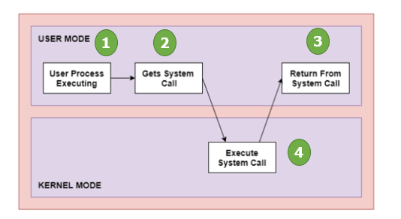
How System Call Works

Slide 4
As you can see in the above-given System Call example diagram.
Step 1) The processes executed in the user mode till the time a system call interrupts it.
Step 2) After that, the system call is executed in the kernel-mode on a priority basis
Step 3) Once system call execution is over, control returns to the user mode
Step 4) The execution of user processes resumed in Kernel mode

Slide 5
Why do you need System Calls in OS
Reading and writing from files demand system calls.
If a file system wants to create or delete files, system calls are required.
System calls are used for the creation and management of new processes.
Network connections need system calls for sending and receiving packets.
Access to hardware devices like scanner, printer, need a system call.

Slide 6
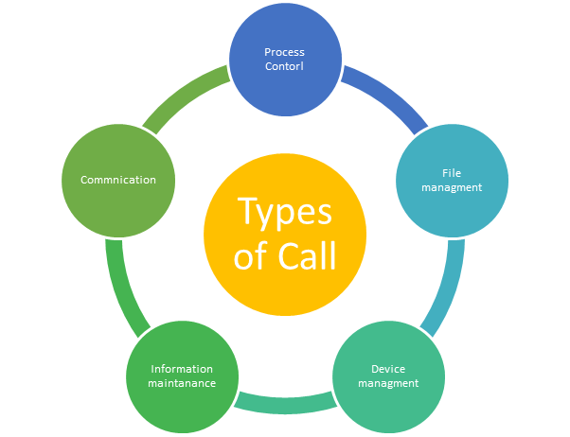
Types of call

Slide 7
Process Control:
Example: fork system call
This system calls perform the task of process creation, process termination, etc.
Functions:
End and Abort
Load and Execute
Create Process and Terminate Process
Wait and Signal Event
Allocate and free memory
#include<stdio.h>
void main()
{
Int r;
Printf(“hello…pid=%d\n”,getpid());
r=fork();
If(r==0)
Printf(“it is child code..\n”);
Else
Printf(“it is parent..\n”);
}
While(1);
}

Slide 8
File Management
Examples: Open system file
File management system calls handle file manipulation jobs like creating a file, reading, and writing, etc.
Functions:
Create a file
Delete file
Open and close file
Read, write, and reposition
Get and set file attributes
#include<stdio.h>
void main()
{
Int fd;
fd=open(“data”,O_RD ONLY);
If(fd<0)
perror(“open”);
return;
}
else
Printf(“fd=%d\n”,fd);

Slide 9
Device Management
Device management does the job of device manipulation like reading from device buffers, writing into device buffers, etc.
Functions:
Request and release device
Logically attach/ detach devices
Get and Set device attributes

Slide 10
Information Maintenance
Example: sleep system call
It handles information and its transfer between the OS and the user program.
Functions:
Get or set time and date
Get process and device attributes
#include<stdio.h>
Int main()
{
printf(”hello\n”);
Sleep(10);
Printf(“done\n”);
}

Slide 11
Communication
These types of system calls are specially used for interprocess communications.
Functions:
Create, delete communications connections
Send, receive message
Help OS to transfer status information
Attach or detach remote devices

Slide 12
Categories | Windows | Unix
Process control | CreateProcess() ExitProcess() WaitForSingleObject() | fork() exit() wait()
Device manipulation | SetConsoleMode() ReadConsole() WriteConsole() | loctl() read() write()
File manipulation | CreateFile() ReadFile() WriteFile() CloseHandle() | Open() Read() write() close!)
Information maintanence | GetCurrentProcessID() SetTimer() Sleep() | getpid() alarm() sleep()
Communication | CreatePipe() CreateFileMapping() MapViewOfFile() | Pipe() shm_open() mmap()

